Slide 1
Virtual tour available here

Slide 2
Going to the theatre
The class will board the bus with your teachers, to drive to the Theatre Royal in Hobart.
The bus will park, and you will have a short walk to the Theatre Royal.
Image credit: Alastair Bett

Slide 3
Entering the Foyer
The main entrance to the Theatre is via a large foyer. There is a ramp to the left which leads to a lift, or you can walk up the stairs.
At the top of the stairs, is the Box Office.
Image credit: Alastair Bett

Slide 4
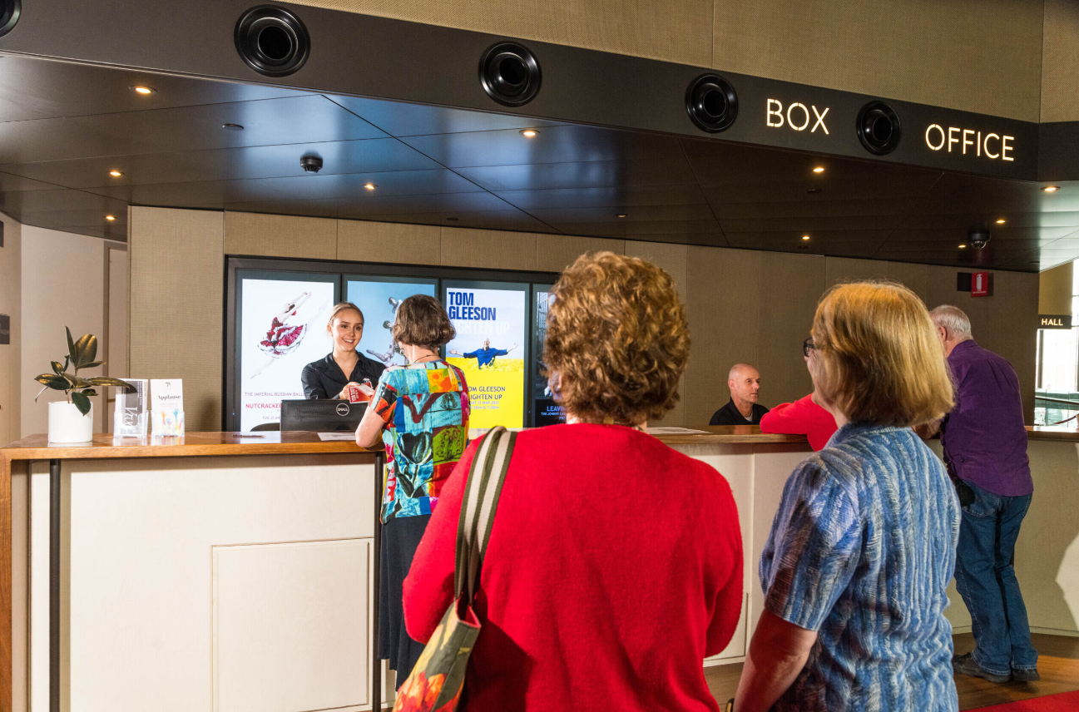
The Box Office
At the Box Office, your teacher will say hello to Theatre Royal staff.
If you need help at any time, you can ask the people who work at the Box Office.
They can help with lots of things, including First Aid or helping you find your teacher or school group if you get separated or lost.
Image credit: Alastair Bett

Slide 5
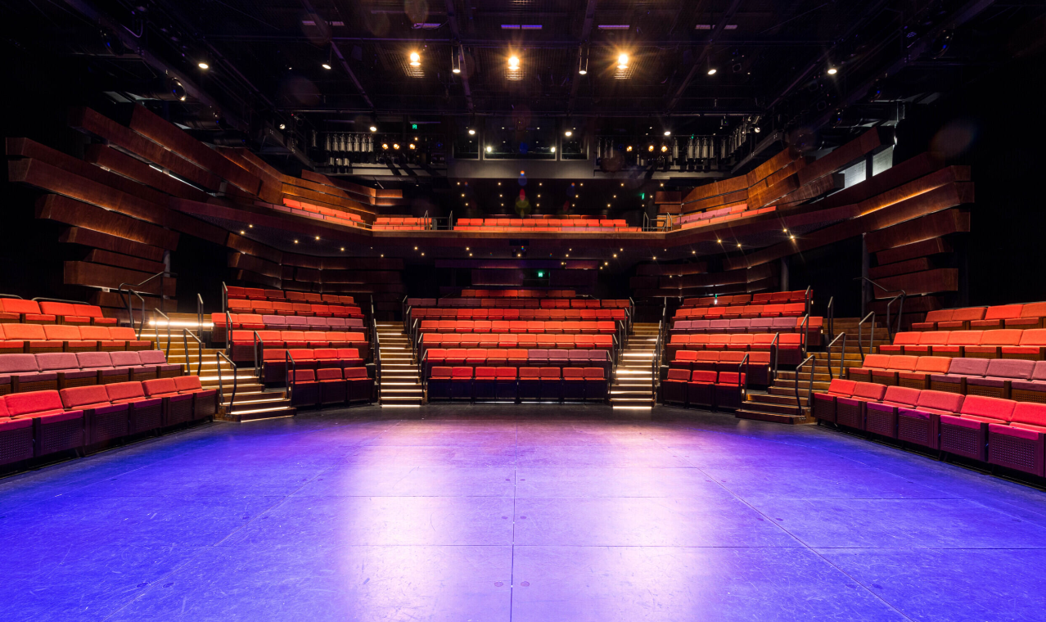
Studio Theatre
If your show is in the Studio Theatre, you will walk up the stairs to Level 4.
Your teacher will let you know where to sit.
There are Ushers, who work for the Theatre Royal and are dressed in black clothes. Their job is to help keep you safe and help you find your seat. It’s very important that you listen to any directions they give you.
Image credit: Alastair Bett

Slide 6
Theatre Royal
If you are watching a performance in the Theatre Royal, your teacher will let you know where to sit.
There are Ushers, who work for the Theatre Royal and are dressed in black clothes. Their job is to help keep you safe and help you find your seat. It’s very important that you listen to any directions they give you.
Image credit: Alastair Bett

Slide 7
During the Show
Wherever you are sitting for the performance, the show will start with an Acknowledgement of Country.
This will be a man's voice, speaking calmly, and the sound will be played through loudspeakers.
This lets us know that we need to pay attention and listen in.
Image credit: Rosie Hastie

Slide 8
During the Show
Image Credit: https://trafficlogix.com/
Then, the lights will go down. This means the show is starting.
During the show, it's important to try and sit calmly and quietly, and watch what happens on the stage.
Image credit: Jillian Mundy

Slide 9
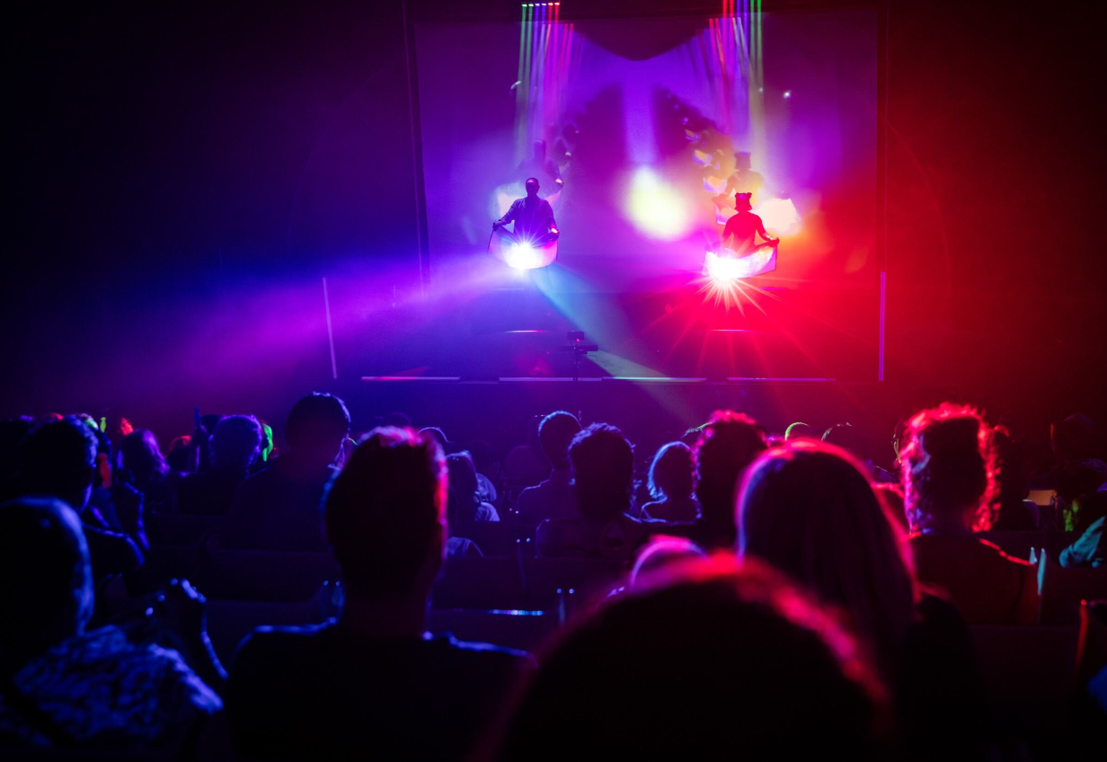
During the Show there may be bright lights and loud noises.
The people on stage (who are called actors) may pretend to be someone else, a character, and you might watch a story that is different from the normal things you see every day.
If you find anything upsetting or it gets too loud or bright, your teacher or an usher can help.
Image credit: I Wish, Patch Theatre and Gravity & Other Myths. Photo: Daniel Boud

Slide 10
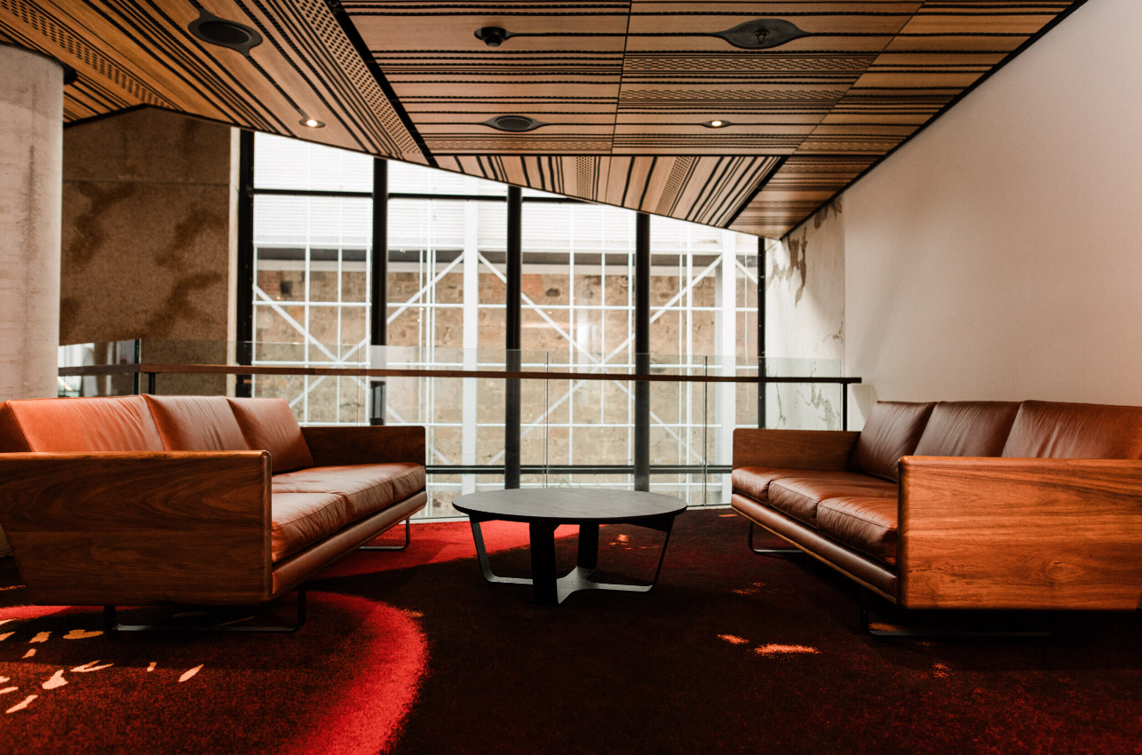
If you need a break, that's okay
If you need a break, an Usher can find a quiet break-out space for you to have some quiet time.
Tell you teacher and they can help too.
hmmm
Image credit: Cassie Sullivan

Slide 11
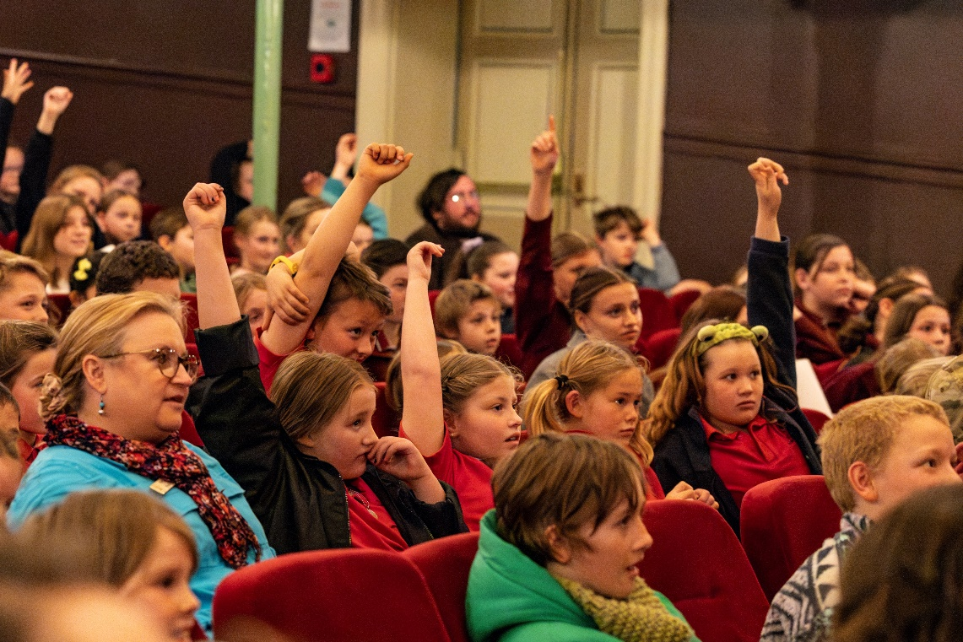
At the end of the show
The show has finished when the lights go dark and your teacher or classmates start to clap their hands. You can clap your hands if you want to. The actors on stage will take a bow.
There might be a Question and Answer session, which means that you can ask a question to the actors on the stage. If you have a question, you can raise your hand, like in class.
Image credit: Jillian Mundy

Slide 12
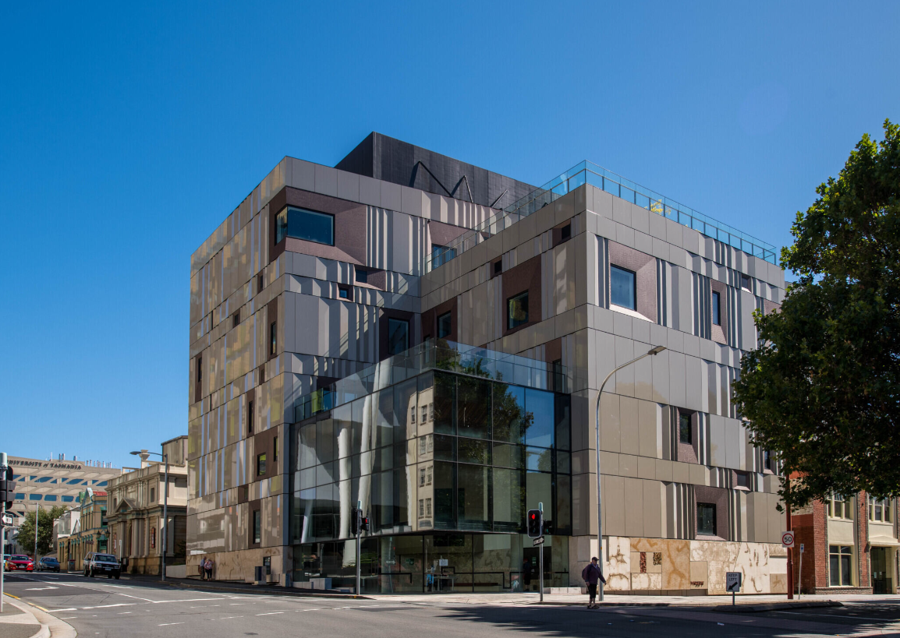
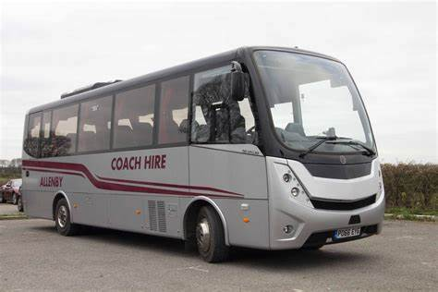
After the show
Your teacher will let you know when it is time to leave the Theatre. You will walk with your friends and teacher to the bus.
You might have a break to eat a snack or go to another activity - your teacher will let you know.
The bus will drive you back to school.
Image credit: https://www.allenbycoachhire.co.uk/
Image credit: Alastair Bett

